Slide 1
ECE20016-01/ITP20003 Java Programming
How does a Java program work?
JC

Slide 2
Tentative Schedule
Weeks | Topics
1 | Introduction Java Runtime environments
2 | Object-oriented concept Packages and objects
3 | Class and its members
4 | Language Basics, Branching and Loop
5 | String and Number classes
6 | Arrays, Recursion
7 | Inheritance, Polymorphism, and Interfaces Abstract data type and Interfaces
8 | Basic data structures ArrayList
9 | HashMap Midterm Exam
10 | Exception Handling, Streams and File I/O (1)
11 | Streams and File I/O (2), Java Programming practice (1)
12 | Java Programming practice (2), Dynamic Data structure and Generics (1)
13 | Dynamic Data structure and Generics (2) GUI and Event-driven Programming (1)
14 | GUI and Event-driven Programming (2), Concurrency (1)
15 | Concurrency (2) , Summary
16 | Final
* This schedule can be modified according to the students’ performance and other reasons.

Slide 3
How does a program generally work?

Slide 4
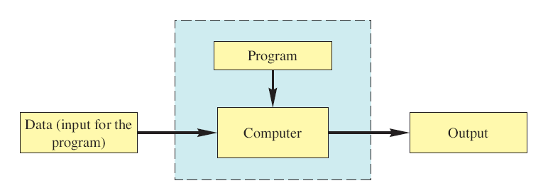
What is a program?
Program: a sequence of instructions for a computer to follow.
Execution of program
Program is executed by computer (+ OS)
Program takes input and produces output!

Slide 5
Programming Languages
Primitive programming languages
Machine language - a sequence of machine instructions
Machine instruction: primitive instructions CPU can run.
Assembly language – a sequence of assembly instruction
Assembly instruction: symbolic representation of machine instruction
Needs translation into machine language (assembler)
High-level programming languages
Human-friendly language to describe the things the computer should do.
Only for human (cannot be executed on computer) ➔ Needs translation into machine language code. (interpreter/compiler)

Slide 6
Interpreter and Compiler
Interpreter - translates and executes each command alternatively
Translates every time the program runs.
Interactive
Compiler - translates the whole (or a part of) program into machine code or another language code (exceptions: Java, C#, …)
Compile once execute often.
Fast

Slide 7
Creating and Running C Programs
Link
Integrating objects and library modules required to execute
Notice! a program can be distributed in multiple source files.
Source 1
Object 1
Executable
Compiling
Source 2
Object 2
…
…
Linking
Source n
Object n
Library
Modules
(printf, scanf,…)

Slide 8
How does a Java program work?
https://docs.oracle.com/javase/tutorial/getStarted/intro/index.html
Textbook: Ch.1.1 ~ 1.6

Slide 9
Creating and Running Java Programs
Java Program
Input (data) for Java Program
Java Compiler
Bytecode Program
Bytecode Interpreter (JVM)
Machine-language Instructions
Computer Execution of Machine-language instruction
Output of Java Program

Slide 10

An overview of the Java Software Development Process
Java Virtual Machine
Compiler
010011…
(Machine code)
Bicycle.java (Source code:
It is just a plain text.)
Bicycle.class
(Bytecode:
Machine language of
a Java Virtual Machine!)
Bicycle running on my computer

Slide 11
What is a Virtual Machine (VM)?
Virtual computer running on your real computer
e.g.,
VirtualBox: https://www.virtualbox.org/
Docker: https://www.docker.com/
Java Virtual Machine (JVM)
A virtual computer that executes only Java program (Java bytecode)
No GUI
Command line program
C:/> java

Slide 12
Java Bytecode
Java compiler translates Java program into bytecode rather than machine language.
Bytecode: machine language of a hypothetical computer known as a virtual machine, called JVM.
Intermediate form between Java program and machine code.
Easy to interpret
Java program
(.java)
Byte-code
(.class)
Machine code
for human
for VM
for machine

Slide 13
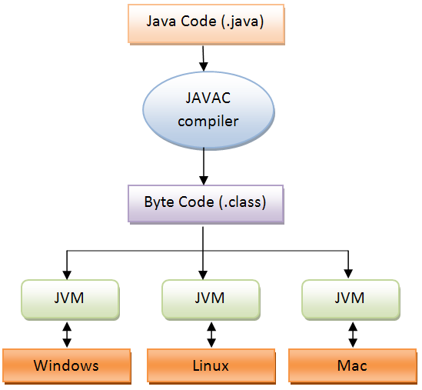
What is pros and cons using Java virtual machine?
Pros
"Compile once, run everywhere!"
Portability
Cons
Performance overhead

Slide 14
Example
JVM
Compiler
010011…
(Machine code)
c:/> javac Bicycle.java
c:/> java Bicycle
Bicycle.java (Source code:
It is just a plain text.)
Bicycle.class
(Bytecode:
Machine language of
a Java Virtual Machine!)
Bicycle executed by JVM running on my computer
To disassemble bytecode (javap -c classfile)
https://stackoverflow.com/questions/14146782/how-do-i-read-a-java-class-file-java-bytecode
https://www.baeldung.com/java-class-view-bytecode
xxd to see the bytecode in hex code

Slide 15
Java Platform
A platform : Hardware or software environment where a program runs
Java Virtual Machine (JVM): A virtual machine for the Java Platform!
Bicycle.java
API
Java Virtual Machine
Hardware-based platform
Java
Platform

Slide 16
Creating and Running Java Programs
Java Program
Input (data) for Java Program
Java Compiler
Bytecode Program
Bytecode Interpreter (JVM)
Machine-language Instructions
Computer Execution of Machine-language instruction
Output of Java Program

Slide 17
Installing Java development kit (JDK)
Java development kit includes Java compilers, Java virtual machine (JVM), other useful libraries and commands
Tutorial materials
Windows user: https://docs.google.com/presentation/d/1ymWKEcgmNVoHkNvUOnKIO5Iy2gthc5GQOgDBL857p8s/edit#slide=id.g4fcd28a31e_0_50
Mac user https://docs.google.com/presentation/d/1Yjpe3hwsI4CEH4Yv5z3knPZcPCoW5q-DtdaBwD3-_OI/edit#slide=id.g4fcd28a31e_0_50

Slide 18
Tentative Schedule
Weeks | Topics
1 | Introduction Java Runtime environments
2 | Object-oriented concept Packages and objects
3 | Class and its members
4 | Language Basics, Branching and Loop
5 | String and Number classes
6 | Arrays, Recursion
7 | Inheritance, Polymorphism, and Interfaces Abstract data type and Interfaces
8 | Basic data structures ArrayList
9 | HashMap Midterm Exam
10 | Exception Handling, Streams and File I/O (1)
11 | Streams and File I/O (2), Java Programming practice (1)
12 | Java Programming practice (2), Dynamic Data structure and Generics (1)
13 | Dynamic Data structure and Generics (2) GUI and Event-driven Programming (1)
14 | GUI and Event-driven Programming (2), Concurrency (1)
15 | Concurrency (2) , Summary
16 | Final
* This schedule can be modified according to the students’ performance and other reasons.

Slide 19

Read https://docs.oracle.com/javase/tutorial/getStarted/cupojava/index.html
Read Ch.1.7 ~ 1.10
JC Nam, jcnam@handong.edu, https://lifove.github.io

